Slide 1
Formal Grammars of English
Jurafsky and Martin Chapter 10
Based on slides from Sameer Singh, Dan Jurafsky, Noah Smith, Slav Petrov, and everyone else they copied from.

Slide 2
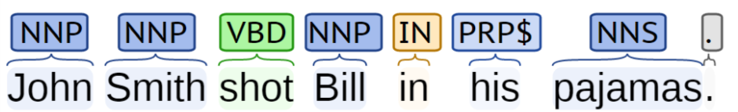
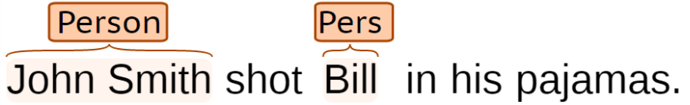
Limitations of Sequence Tags
John Smith shot Bill in his pajamas.
What happened?
Who shot who?
Who was wearing the pajamas?
Using http://nlp.stanford.edu:8080/corenlp/process
Notes:
Give an example sentence and talk about constituent and phrases

Slide 3
How do words group together in English?
A noun phrase is a sequence of words surrounding at least one noun.
What evidence do we have that these words group together?
Noun Phrases
Harry the Horse
the Broadway coppers
they
a high-class spot such as Mindy’s
the reason he comes into the Hot Box
three parties from Brooklyn
Notes:
Previously we discussed POS tagging.
Part-of-speech categories cam act as a kind of equivalence class for words.
One piece of evidence is that they can all appear in similar syntactic environments, for example, before a verb.

Slide 4
Constituents
Constituent behave as a unit that can be rearranged:
John talked [to the children] [about drugs].
John talked [about drugs] [to the children].
John talked drugs to the children about
Or substituted/expanded:
John talked [to the children taking the drugs] [about alcohol].
Harry the Horse
a high-class spot such as Mindy’s
the Broadway coppers
the reason he comes into the Hot Box
they
three parties from Brooklyn
arrive(s)
attract(s)
love(s)
sit(s)
X
“Noun phrases appear before verbs in English.”

Slide 5
Constituents and Grammars
Grammar
Tells you how the constituents can be arranged
Implicit knowledge for us (we often can’t tell why something is wrong)
Generate all, and only, the possible sentences of the language
Different from meaning:
Colorless green ideas sleep furiously.
The words are in the right order,
And that ideas are green and colorless,
And that ideas sleep,
And that sleeping is done furiously,
As opposed to: “sleep green furiously ideas colorless”

Slide 6
Uses of Parsing
[ send [the text message from James] [to Sharon] ]
[ translate [the message] [from Hindi] [to English] ]
Grammar checkers
Dialog systems
High precision question answering
Named entity recognition
Sentence compression
Extracting opinions about products
Improved interaction in computer games
Helping linguists find data
Machine translation
Relation extraction systems

Slide 7
Basic Grammar: Regular Expr.
You can capture individual words:
(man|dog|cat)
Simple sentences:
(man|dog|cat)(ate|loves|consumed)(.|food|lunch)
Infinite length? Yes!
men (who like (cats|dogs))* cry.
S2
like
who
S3
dogs
Finite State Machine
Start
men
S1
cats
End
cry
But too weak for English.

Slide 8
Context-Free Grammars
Grammar, G
Terminal Symbols
Non-terminal Symbols
Rules
Grammar applies rules recursively..
If we can construct the input sentence, it is in the grammar, otherwise not.

Slide 9
Context-Free Grammars
Grammar, G
Terminal Symbols
Non-terminal Symbols
Rules
Grammar applies rules recursively..
If we can construct the input sentence, it is in the grammar, otherwise not.

Slide 10
Context Free Grammars

Slide 11
Context Free Grammars

Slide 12
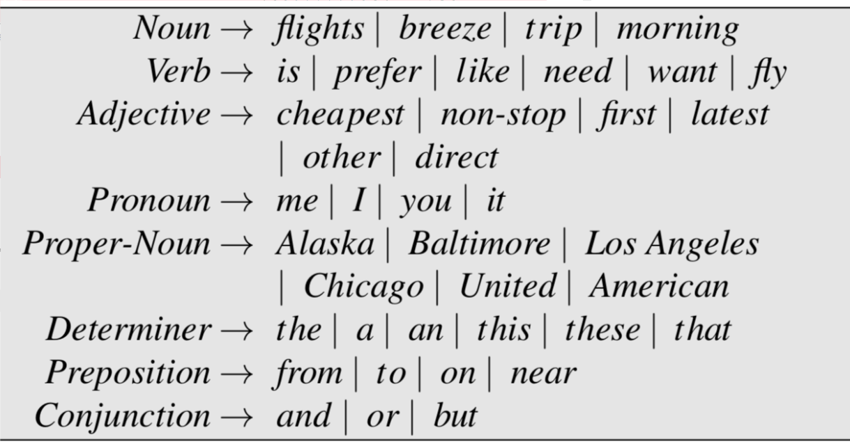
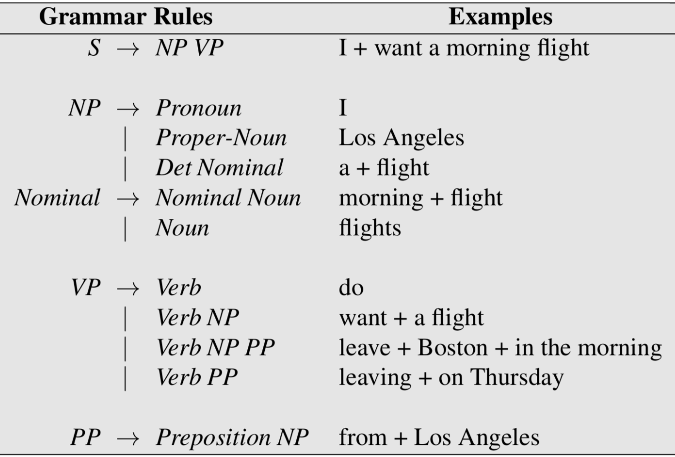
Example CFG

Slide 13
Example CFG

Slide 14
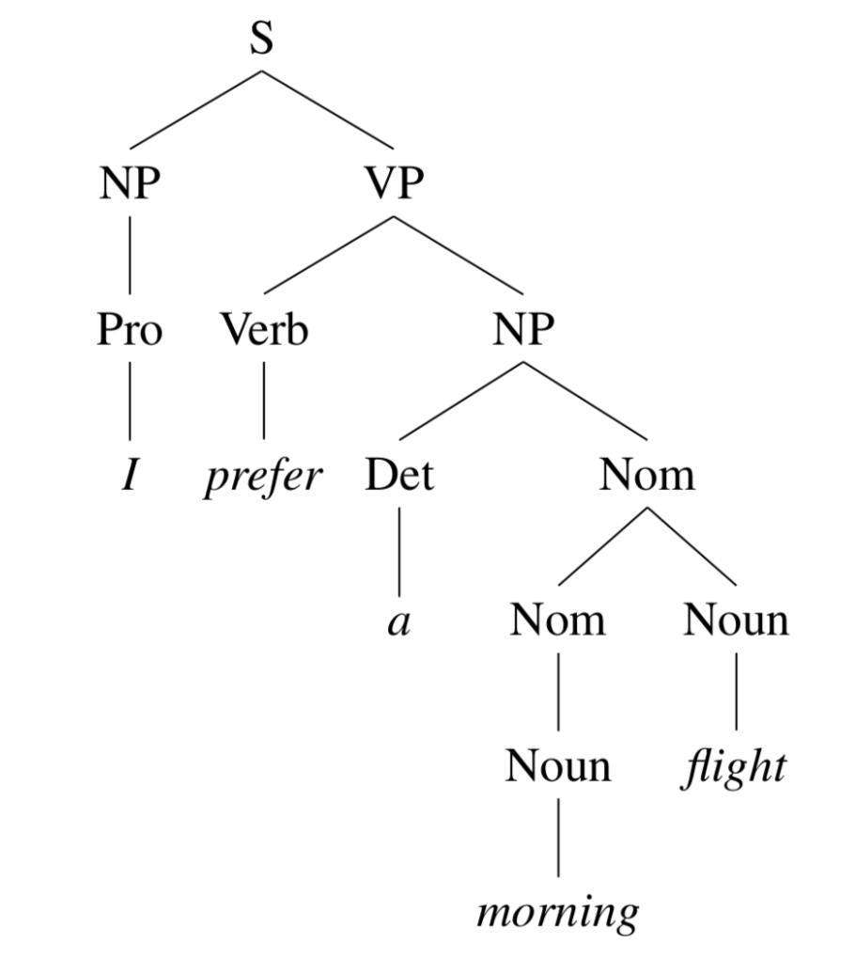
Example Parse Tree
I prefer a morning flight.

Slide 15
Example Parse Tree
I prefer a morning flight.

Slide 16
Example Parse Tree: Brackets
I prefer a morning flight.

Slide 17
Example Parse Tree: Brackets
I prefer a morning flight.

Slide 18
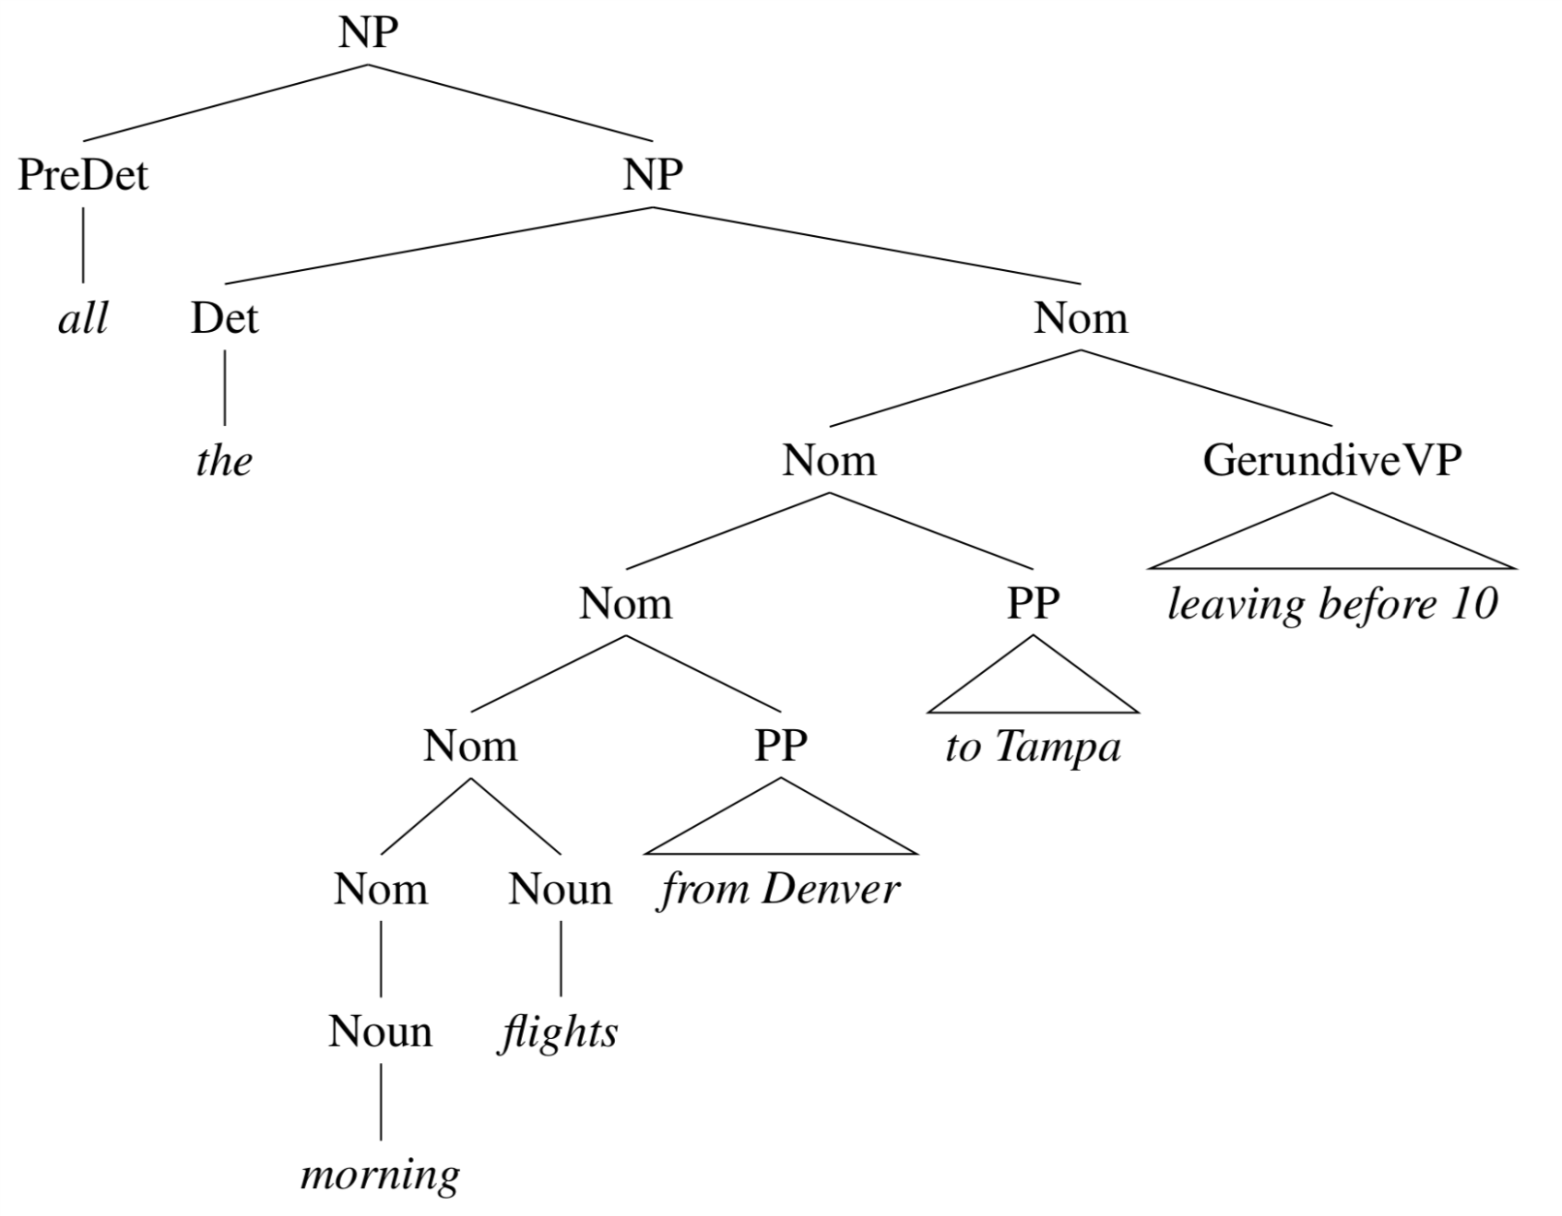
More details: Noun Phrases
Simple Noun Phrases
NP → ProperNoun
NP → Det Nominal
Nominal → Noun | Noun Nominal
Complex Noun Phrases
“all the morning flights from Denver to Tampa leaving before 10”

Slide 19
Recursive Noun Phrases
this is the house
this is the house that Jack built
this is the cat that lives in the house that Jack built
this is the dog that chased the cat that lives in the house that Jack built
this is the flea that bit the dog that chased the cat that lives in the house the Jack built
this is the virus that infected the flea that bit the dog that chased the cat that lives in the house that Jack built

Slide 20
Recursive Noun Phrases
this is the house
this is the house that Jack built
this is the cat that lives in the house that Jack built
this is the dog that chased the cat that lives in the house that Jack built
this is the flea that bit the dog that chased the cat that lives in the house the Jack built
this is the virus that infected the flea that bit the dog that chased the cat that lives in the house that Jack built

Slide 21
More details: Verb Phrases
VP → Verb disappear
VP → Verb NP prefer a morning flight
VP → Verb NP PP leave Boston in the morning
VP → Verb PP leave in the morning
Simple Verb Phrases
Sneezed: John sneezed.
Find: Please find a flight to NY.
Give: Give me a cheaper fare.
Help: Can you help me with a flight?
Prefer: I prefer to leave earlier.
Told: I was told United has a flight.
But all verbs are not the same!
(this grammar overgenerates)
Solution: subcategorize!

Slide 22
Types of Sentences
Declarative
S → NP VP
A plane left.
Imperative
S → VP
Show the plane.
Yes/no Questions
S → Aux NP VP
Did the plane leave?
Wh-Questions
S → WhNP Aux NP VP
When did the plane leave?

Slide 23
Types of Sentences
Declarative
S → NP VP
A plane left.
Imperative
S → VP
Show the plane.
Yes/no Questions
S → Aux NP VP
Did the plane leave?
Wh-Questions
S → WhNP Aux NP VP
When did the plane leave?

Slide 24
Source of Grammar?
Manual
Write symbolic grammar (CFG or often richer) and lexicon
S → NP VP NN → interest
NP → (DT) NN NNS → rates
NP → NN NNS NNS → raises
NP → NNP VBP → interest
VP → V NP VBZ → rates
Used grammar/proof systems to prove parses from words
Fed raises interest rates 0.5% in effort to control inflation
Minimal grammar: 36 parses
Simple 10 rule grammar: 592 parses
Real-size broad-coverage grammar: millions of parses
Noam Chomsky

Slide 25
Source of Grammar?
From data!
The Penn Treebank
Building a treebank seems a lot slower and less useful than building a grammar
But a treebank gives us many things
Reusability of the labor
Many parsers, POS taggers, etc.
Valuable resource for linguistics
Broad coverage
Frequencies and distributional information
A way to evaluate systems
[Marcus et al. 1993, Computational Linguistics]

Slide 26
( (S
(NP-SBJ (DT The) (NN move))
(VP (VBD followed)
(NP
(NP (DT a) (NN round))
(PP (IN of)
(NP
(NP (JJ similar) (NNS increases))
(PP (IN by)
(NP (JJ other) (NNS lenders)))
(PP (IN against)
(NP (NNP Arizona) (JJ real) (NN estate) (NNS loans))))))
(, ,)
(S-ADV
(NP-SBJ (-NONE- *))
(VP (VBG reflecting)
(NP
(NP (DT a) (VBG continuing) (NN decline))
(PP-LOC (IN in)
(NP (DT that) (NN market)))))))
(. .)))

Slide 27
Some of the rules, with counts
40717 PP → IN NP
33803 S → NP-SBJ VP
22513 NP-SBJ → -NONE-
21877 NP → NP PP
20740 NP → DT NN
14153 S → NP-SBJ VP .
12922 VP → TO VP
11881 PP-LOC → IN NP
11467 NP-SBJ → PRP
11378 NP → -NONE-
11291 NP → NN
...
989 VP → VBG S
985 NP-SBJ → NN
983 PP-MNR → IN NP
983 NP-SBJ → DT
969 VP → VBN VP
100 VP → VBD PP-PRD
100 PRN → : NP :
100 NP → DT JJS
100 NP-CLR → NN
99 NP-SBJ-1 → DT NNP
98 VP → VBN NP PP-DIR
98 VP → VBD PP-TMP
98 PP-TMP → VBG NP
97 VP → VBD ADVP-TMP VP
...
10 WHNP-1 → WRB JJ
10 VP → VP CC VP PP-TMP
10 VP → VP CC VP ADVP-MNR
10 VP → VBZ S , SBAR-ADV
10 VP → VBZ S ADVP-TMP
4500 rules
for VP!

Slide 28
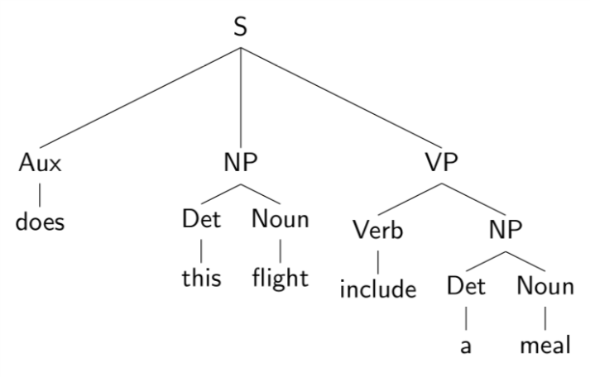
Evaluating Parses
Each parse tree is represented by a list of tuples:
Use this to estimate precision/recall!

Slide 29
Evaluating Parses
Each parse tree is represented by a list of tuples:
Use this to estimate precision/recall!

Slide 30
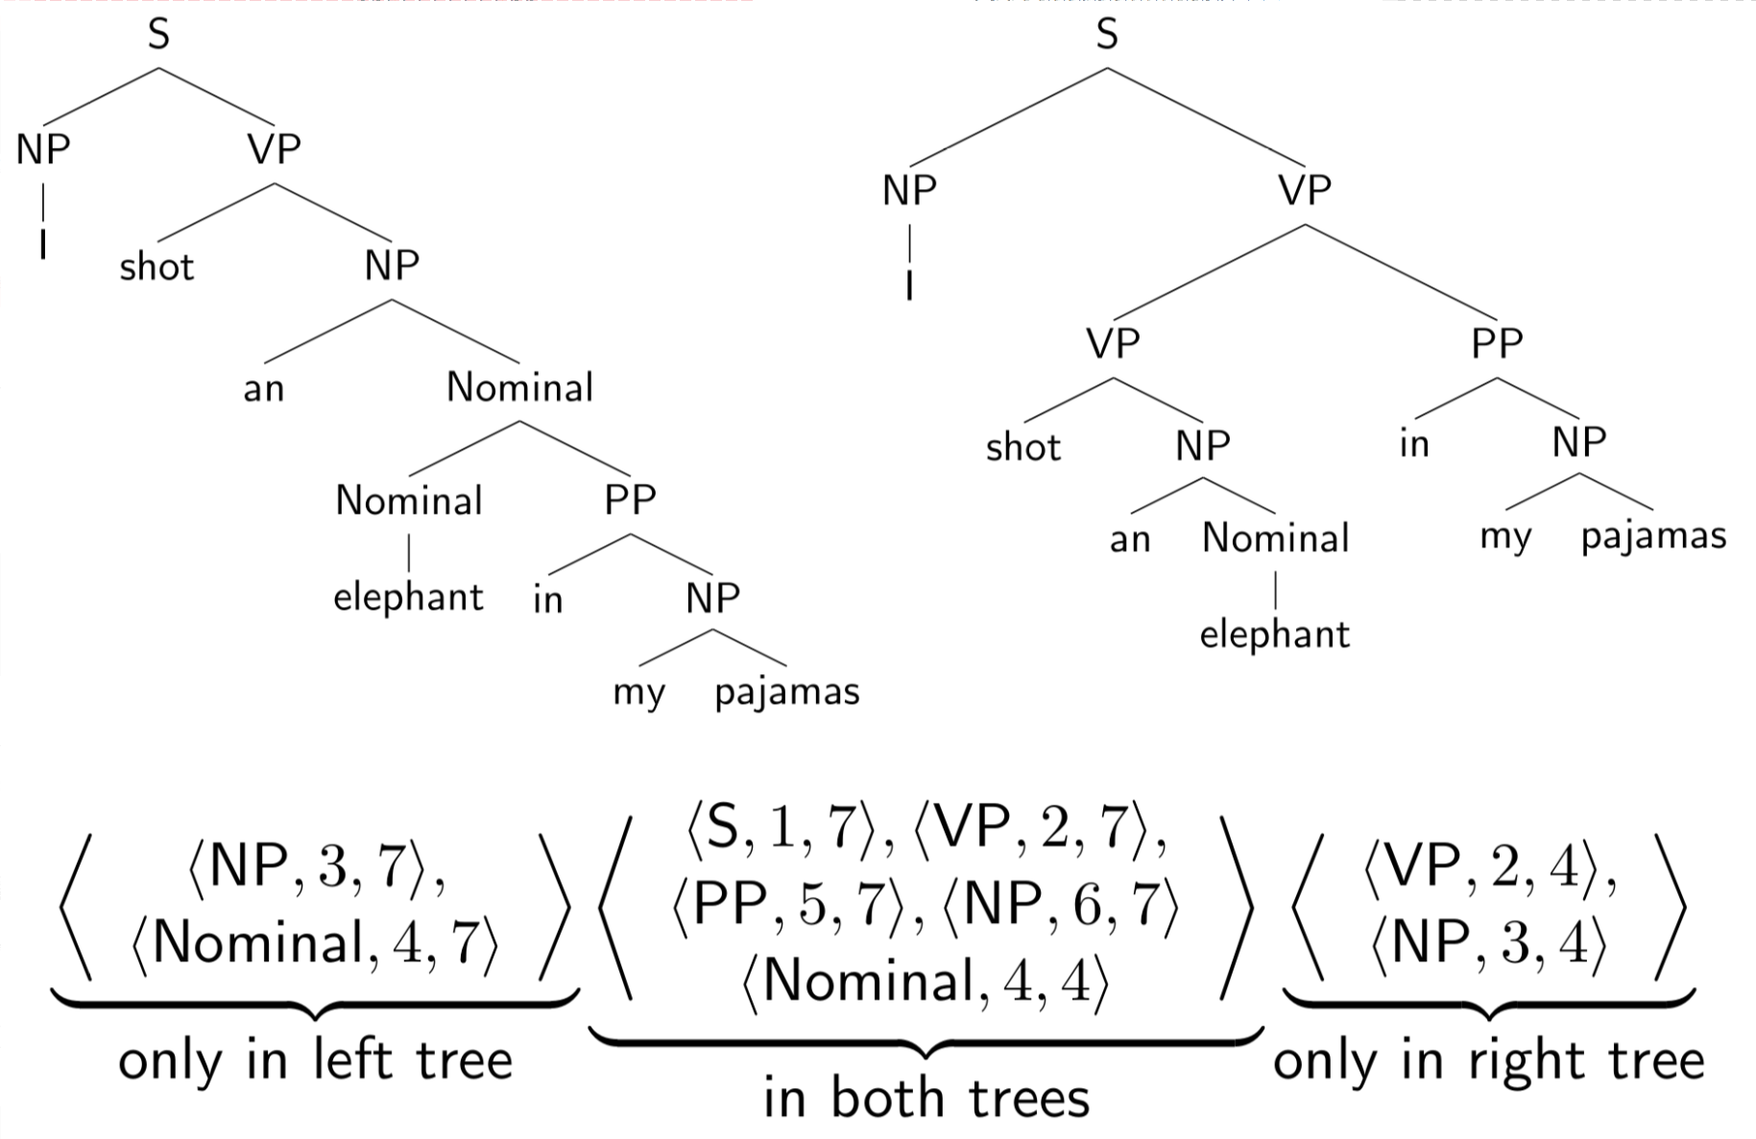
Evaluating Parses: Example

Slide 31
Evaluating Parses: Example

Slide 32
Outline
Context Free Grammars
Parsing: CKY Algorithm
Extensions: Probabilistic and Lexicalized
Dependency Parsing

Slide 33
The Parsing Problem
Given sentence x and grammar G,
Recognition
Is sentence x in the grammar? If so, prove it.
“Proof” is a deduction, valid parse tree.
Parsing
Show one or more derivations for x in G.
Even with small grammars, brute force grows exponentially!
“Book that flight”

Slide 34
Left to Right?
The old man the boat.
The complex houses married and single soldiers and their families.
Garden Path Sentences

Slide 35
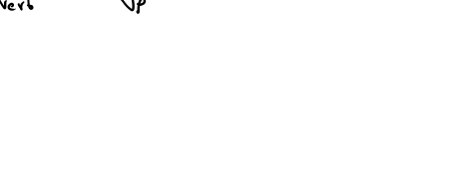
Left to Right?
The old man the boat.
The complex houses married and single soldiers and their families.
Garden Path Sentences

Slide 36
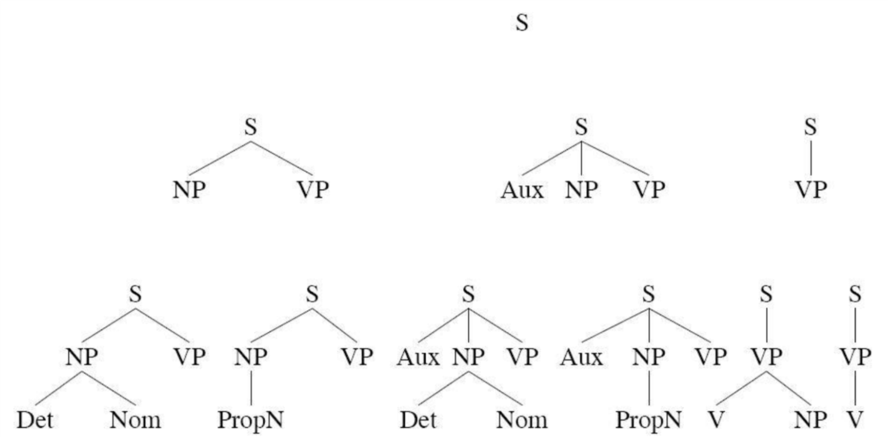
Top Down Parsing
“Book that flight”
Considers only valid trees
But are inconsistent with the words!

Slide 37
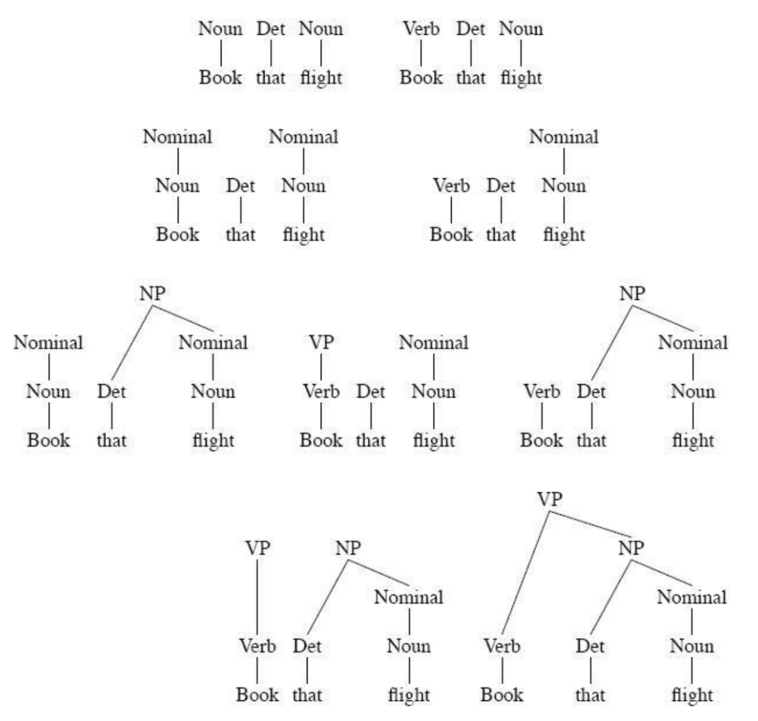
Bottom-up Parsing
“Book that flight”
Builds only consistent trees
But most of them are invalid (don’t go anywhere)!

Slide 38
Chomsky Normal Form
Context free grammar where all non-terminals to go:
2 non-terminals, or
A single terminal
A → B C
D → w
Converting to CNF
Case 1
Case 2
A → B
B → C D
B → w
A → C D
A → w
A → X E
X → Y D
Y → B C
A → B C D E

Slide 39
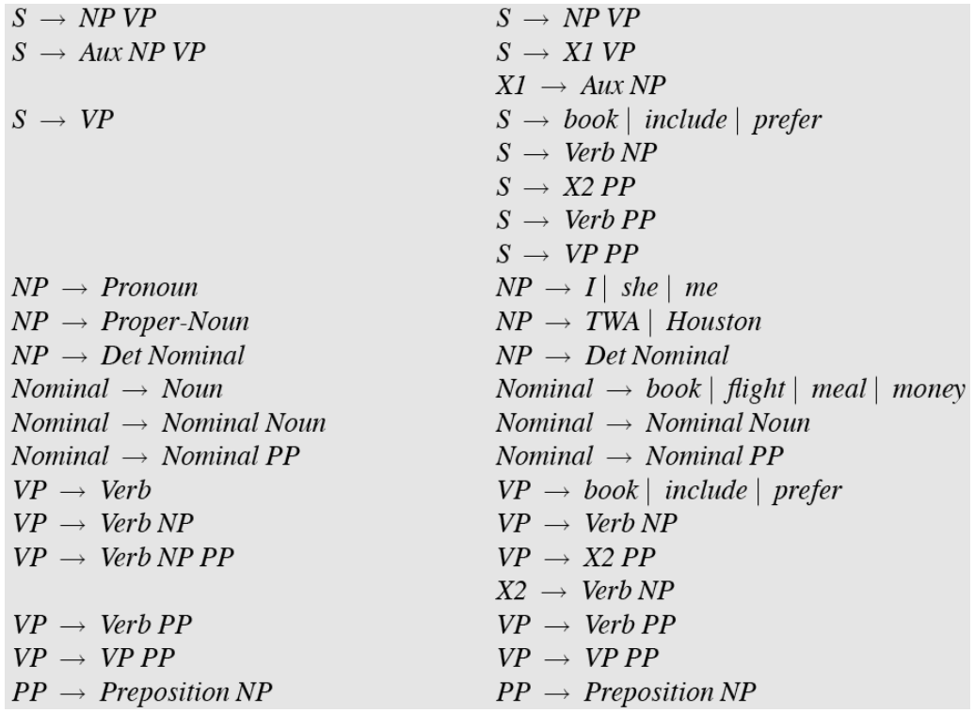
Original Grammar
Chomsky Normal Form

Slide 40
Dynamic Programming
table[i,j] = Set of all valid non-terminals for the constituent span (i,j)
A
(j-1,j)
Rule: A → word[j]
Base case
A should be in table[j-1,j]
word[j]
Recursion
Rule: A → B C
(i,j)
A
If you find a k such that
B is in table[i,k], and
C is in table[k,j], then A should be in table[i,j]
C
B
(i,k)
(k,j)

Slide 41
Dynamic Programming
table[i,j] = Set of all valid non-terminals for the constituent span (i,j)
A
(j-1,j)
Rule: A → word[j]
Base case
A should be in table[j-1,j]
word[j]
Recursion
Rule: A → B C
(i,j)
A
If you find a k such that
B is in table[i,k], and
C is in table[k,j], then A should be in table[i,j]
C
B
(i,k)
(k,j)

Slide 42
CKY Algorithm
Book
the
flight
through
TWA
Notes:
01, S VP Verb Nom Noun; 12, Det; 23 Nom N; 3,4 Prep; 4,5 NP, Proper
13 NP; 35 PP;
03, S, VP, X2; 25, Nom
15 NP
05 X2, VP, VP, S(01,15), S(03,35,X2 PP), S(03,35,VP PP)

Slide 43
CKY Algorithm
Book
the
flight
through
TWA
Notes:
01, S VP Verb Nom Noun; 12, Det; 23 Nom N; 3,4 Prep; 4,5 NP, Proper
13 NP; 35 PP;
03, S, VP, X2; 25, Nom
15 NP
05 X2, VP, VP, S(01,15), S(03,35,X2 PP), S(03,35,VP PP)

Slide 44
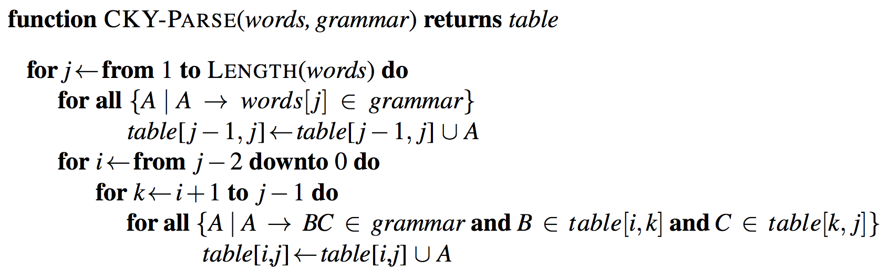
CKY Algorithm

Slide 45
CKY Algorithm

Slide 46
CKY Algorithm: Complexity
|N|: Number of non-terminals
|R|: Number of rules
n: Number of tokens in the sentence
Memory
Time
Notes:
Nn^2 and Rn^3

Slide 47
CKY Algorithm: Complexity
|N|: Number of non-terminals
|R|: Number of rules
n: Number of tokens in the sentence
Memory
Time
Notes:
Nn^2 and Rn^3

Slide 48
Outline
Parsing: CKY Algorithm
Extensions: Probabilistic and Lexicalized
Dependency Parsing

Slide 49
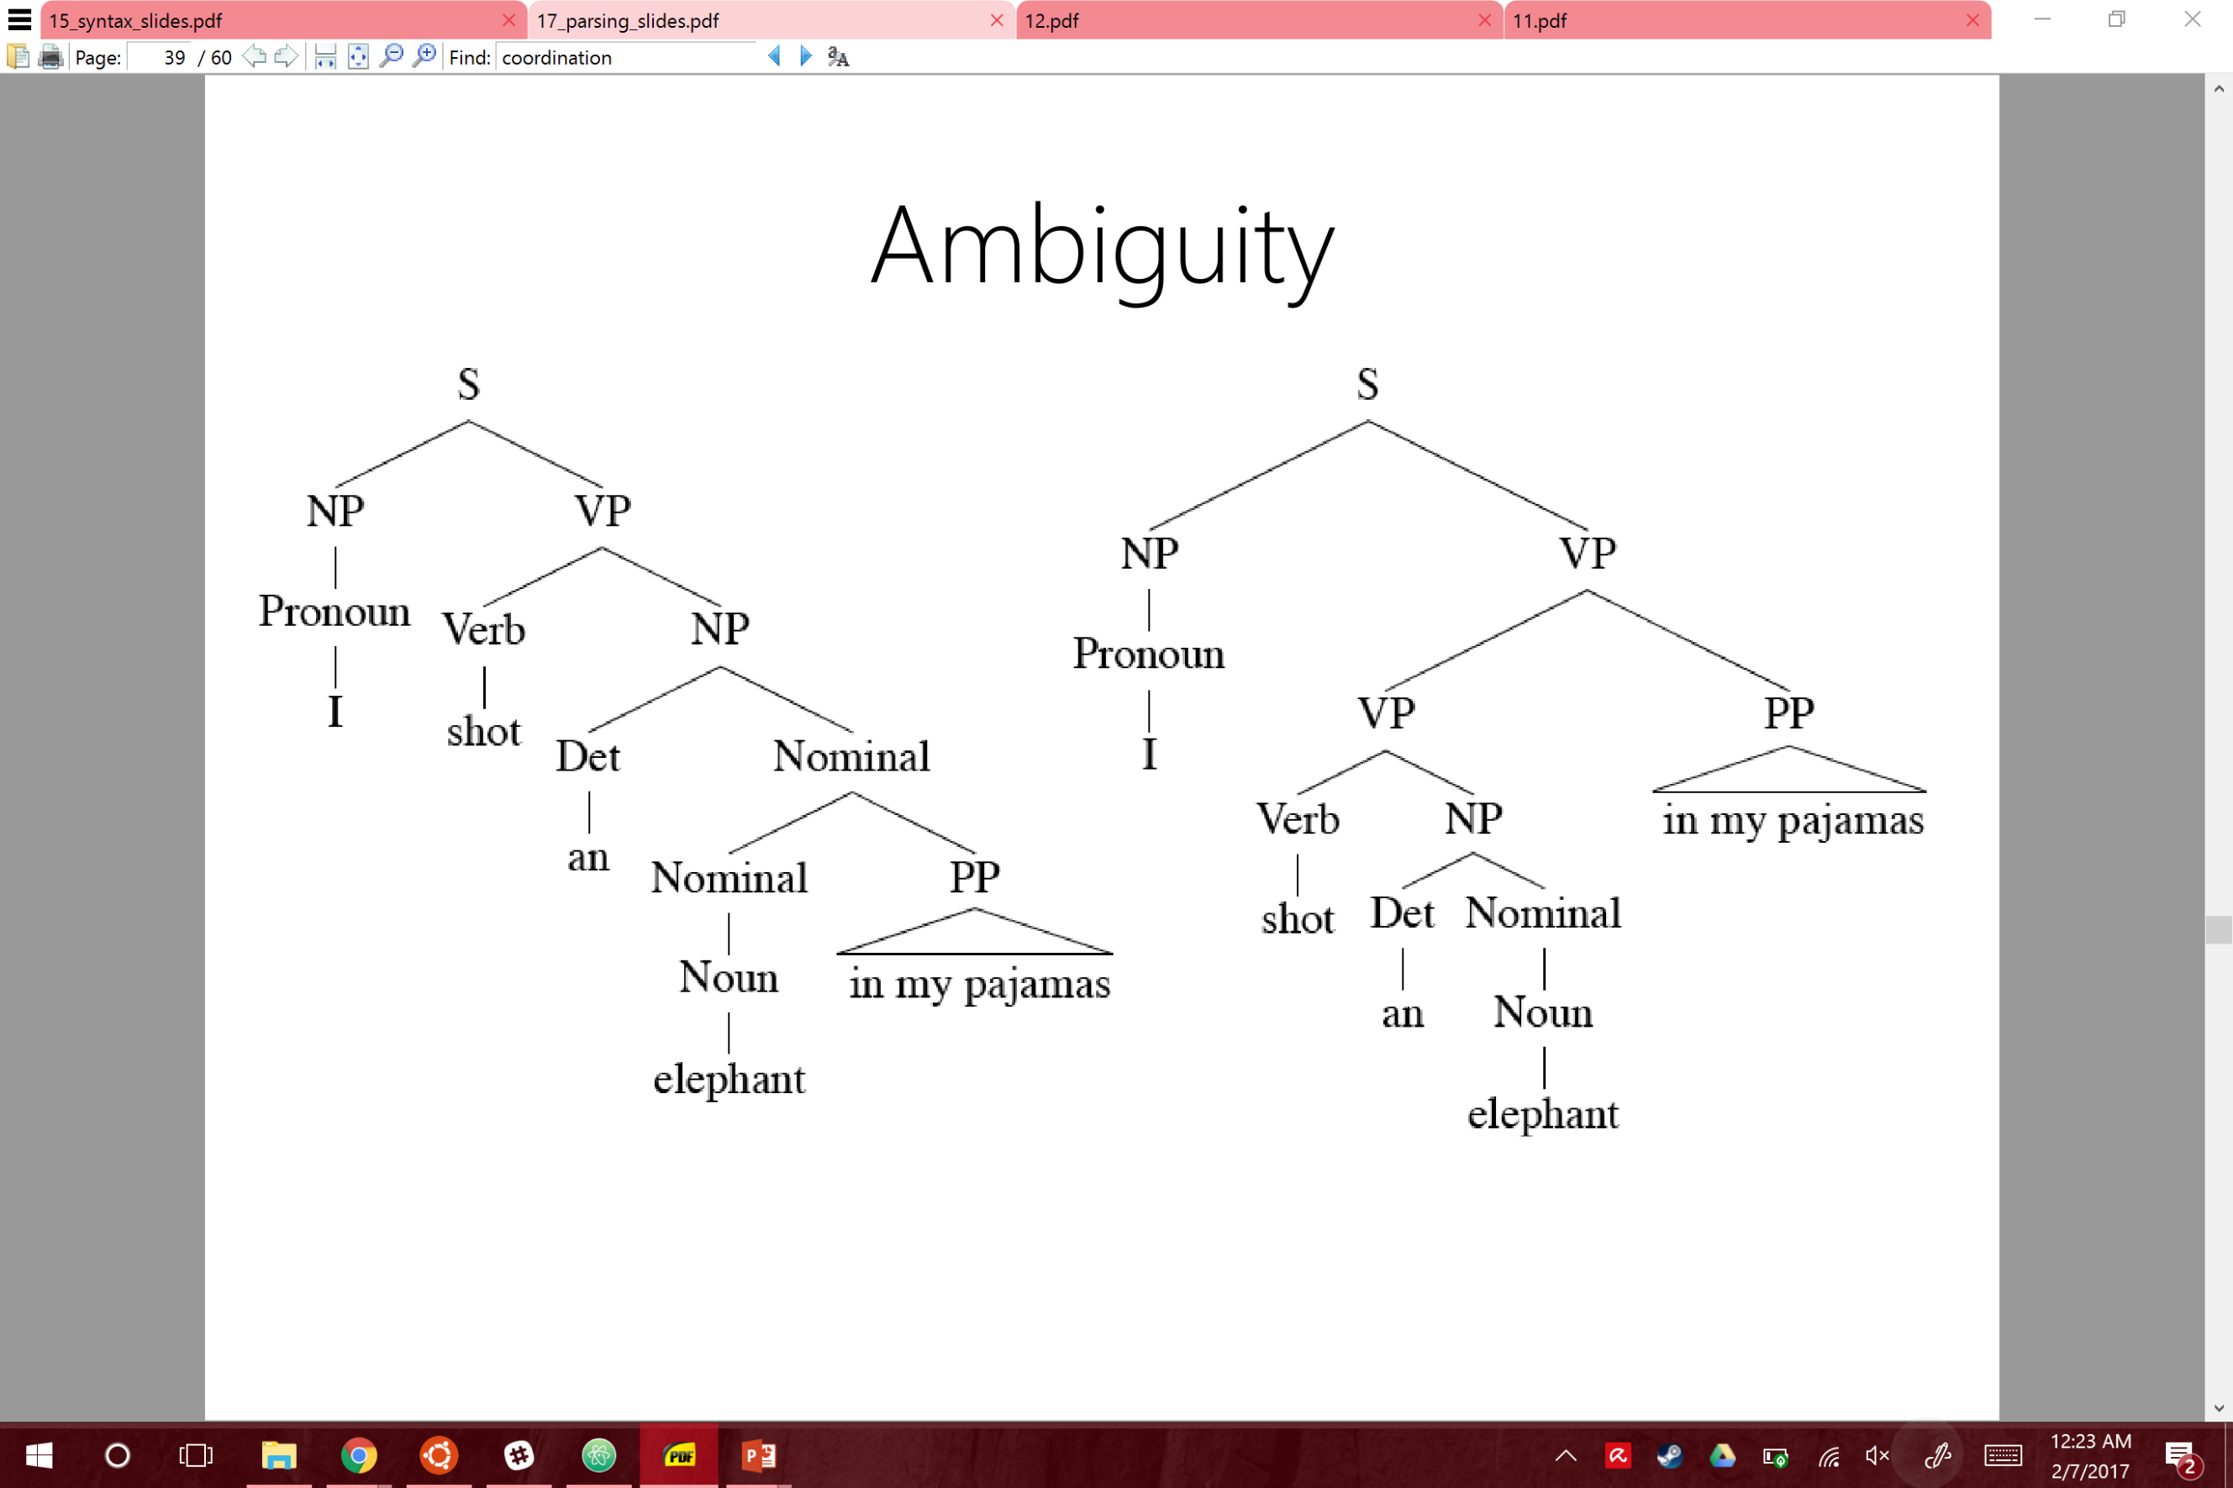
Ambiguity: Which parse?
I shot an elephant in my pajamas.

Slide 50
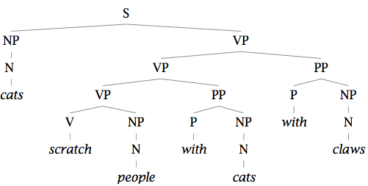
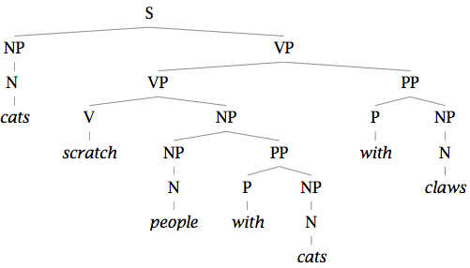
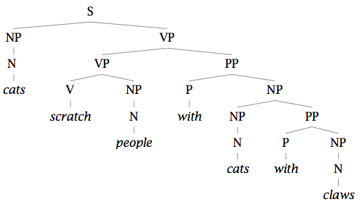
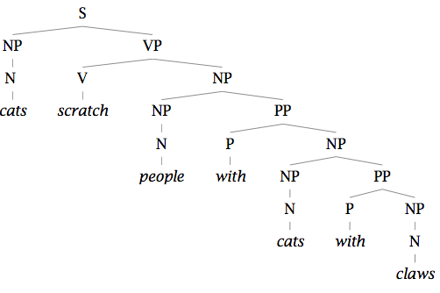
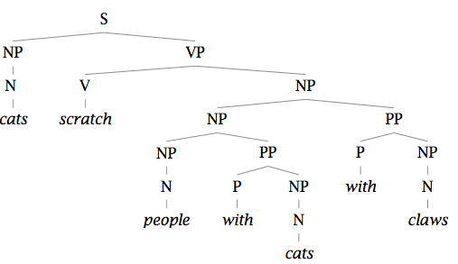
Finding the Best Parse Tree
Cats scratch people with cats with claws.

Slide 51
Finding the Best Parse Tree
Cats scratch people with cats with claws.

Slide 52
Probabilistic CFGs
Same as a regular context-free grammar:
Terminal, non-terminals, and rules
Additionally, attach a probability to each rule!
Rule: A → B C
Probability: P(A → B C | A)
Compute the probability of a parse tree:

Slide 53
Probabilistic CFGs
Same as a regular context-free grammar:
Terminal, non-terminals, and rules
Additionally, attach a probability to each rule!
Rule: A → B C
Probability: P(A → B C | A)
Compute the probability of a parse tree:

Slide 54
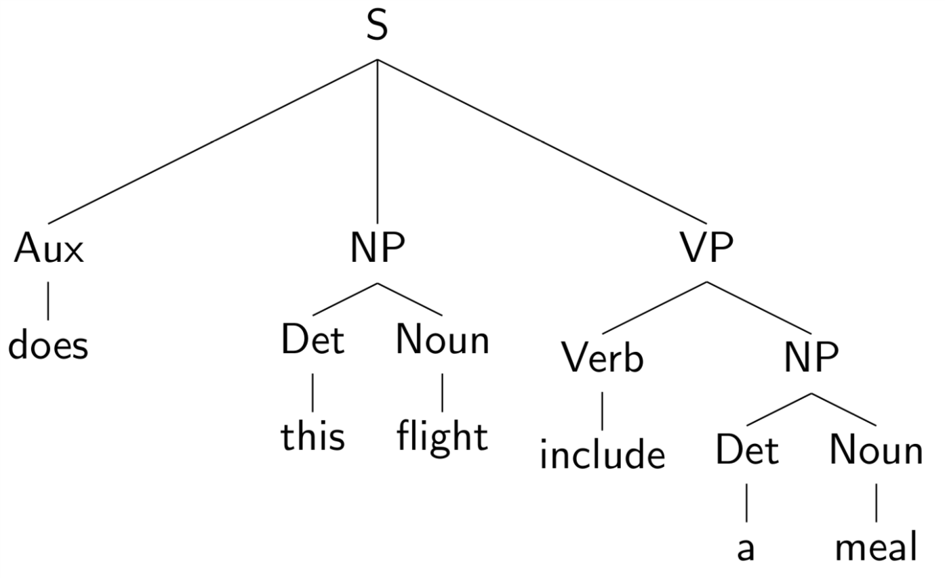
Example of a PCFG

Slide 55
Example of a PCFG

Slide 56
Estimating the probabilities

Slide 57
Estimating the probabilities

Slide 58
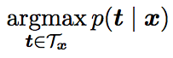
The Parsing Problem
Given sentence x and grammar G,
Recognition
Is sentence x in the grammar? If so, prove it.
“Proof” is a deduction, valid parse tree.
Parsing
Show one or more derivations for x in G.
Even with small grammars, grows exponentially!

Slide 59
Probabilistic CKY Algorithm
T[i,j,A] = Probability of the best parse with root A for the span (i,j)
A
(j-1,j)
Rule: P( A → word[j] )
Base case
T[j-1,j,A] = P(word[j] | A)
word[j]
Recursion
Rule: P( A → B C )
(i,j)
A
Try every position k, and every non-terminal pair:
B
C
T[i,j,A] = max P(B C| A) T[i,k,B] T[k,j,C]
(i,k)
(k,j)

Slide 60
Lexicalized PCFGs

Slide 61
Lexicalized PCFGs

Slide 62
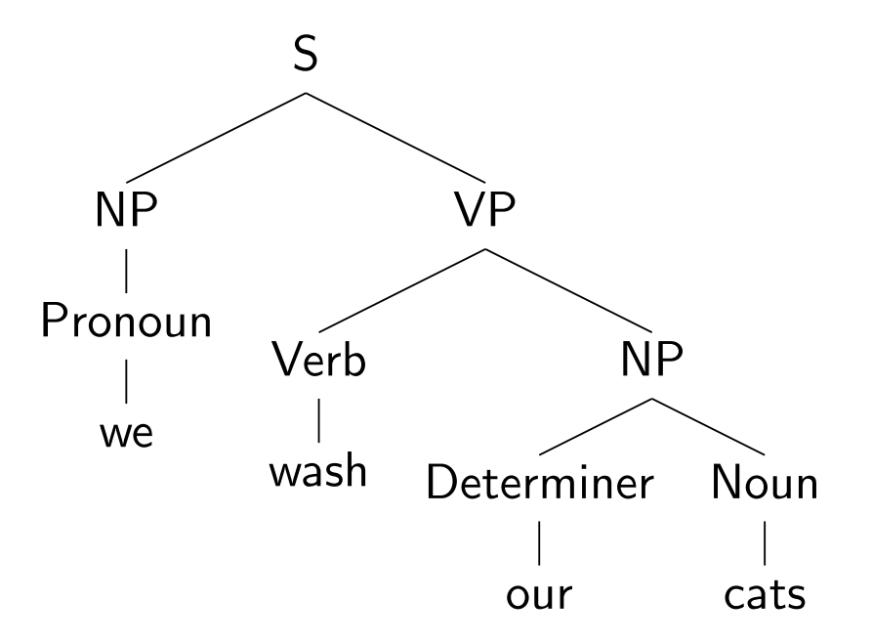
Lexicalizing a CFG

Slide 63
Lexicalizing a CFG

Slide 64
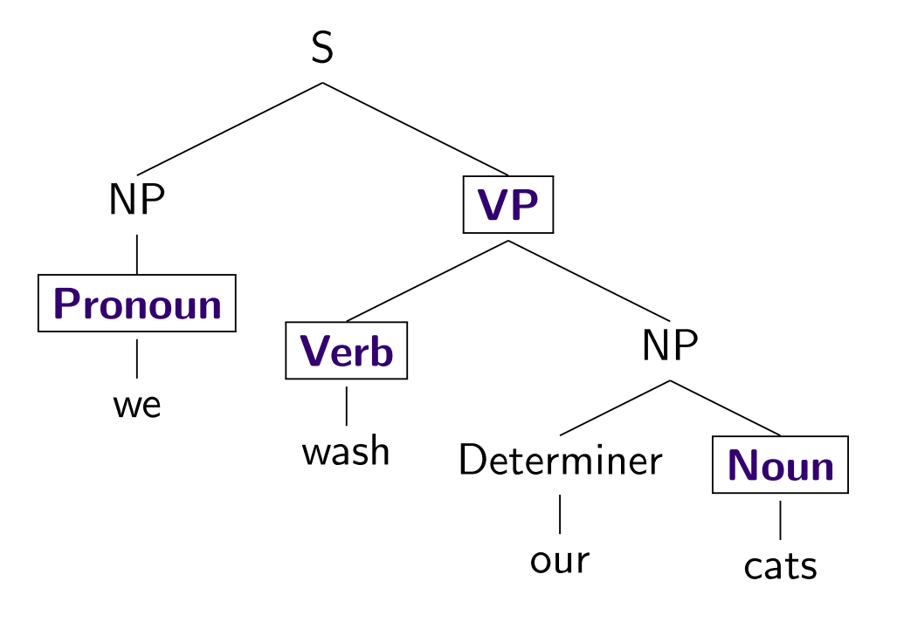
Lexicalizing a CFG

Slide 65
Lexicalizing a CFG

Slide 66
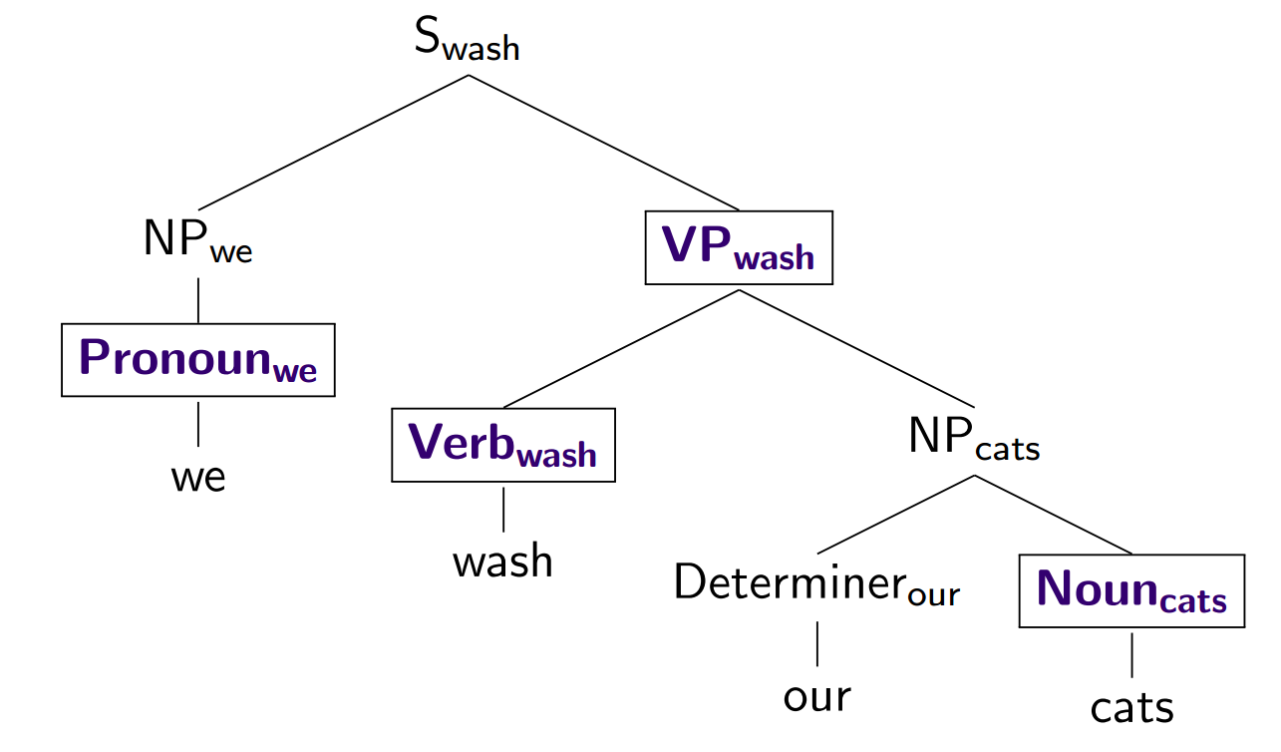
Lexicalizing a CFG

Slide 67
Outline
Parsing: CKY Algorithm
Extensions: Probabilistic and Lexicalized
Dependency Parsing

Slide 68
Dependencies
Represent only the syntactic dependencies…

Slide 69
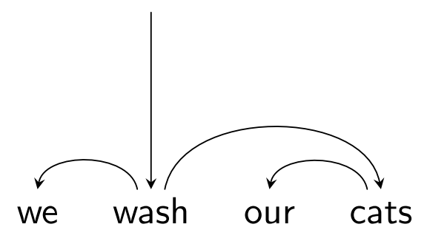
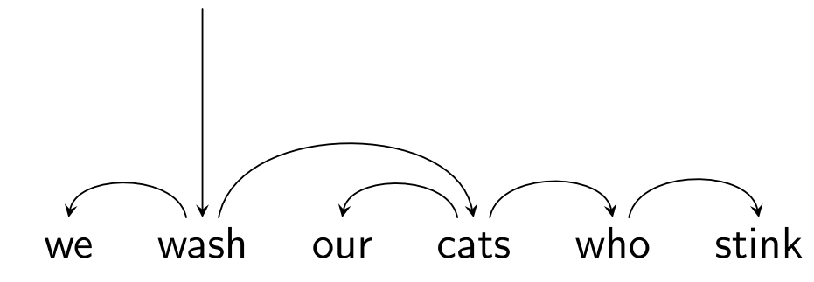
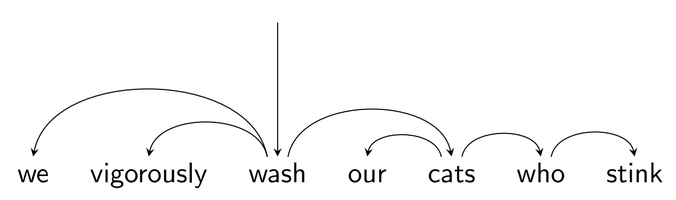
Nested Structure = Subtrees

Slide 70
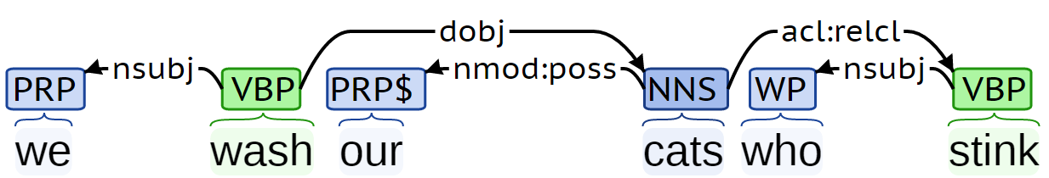
Dependency Labels

Slide 71
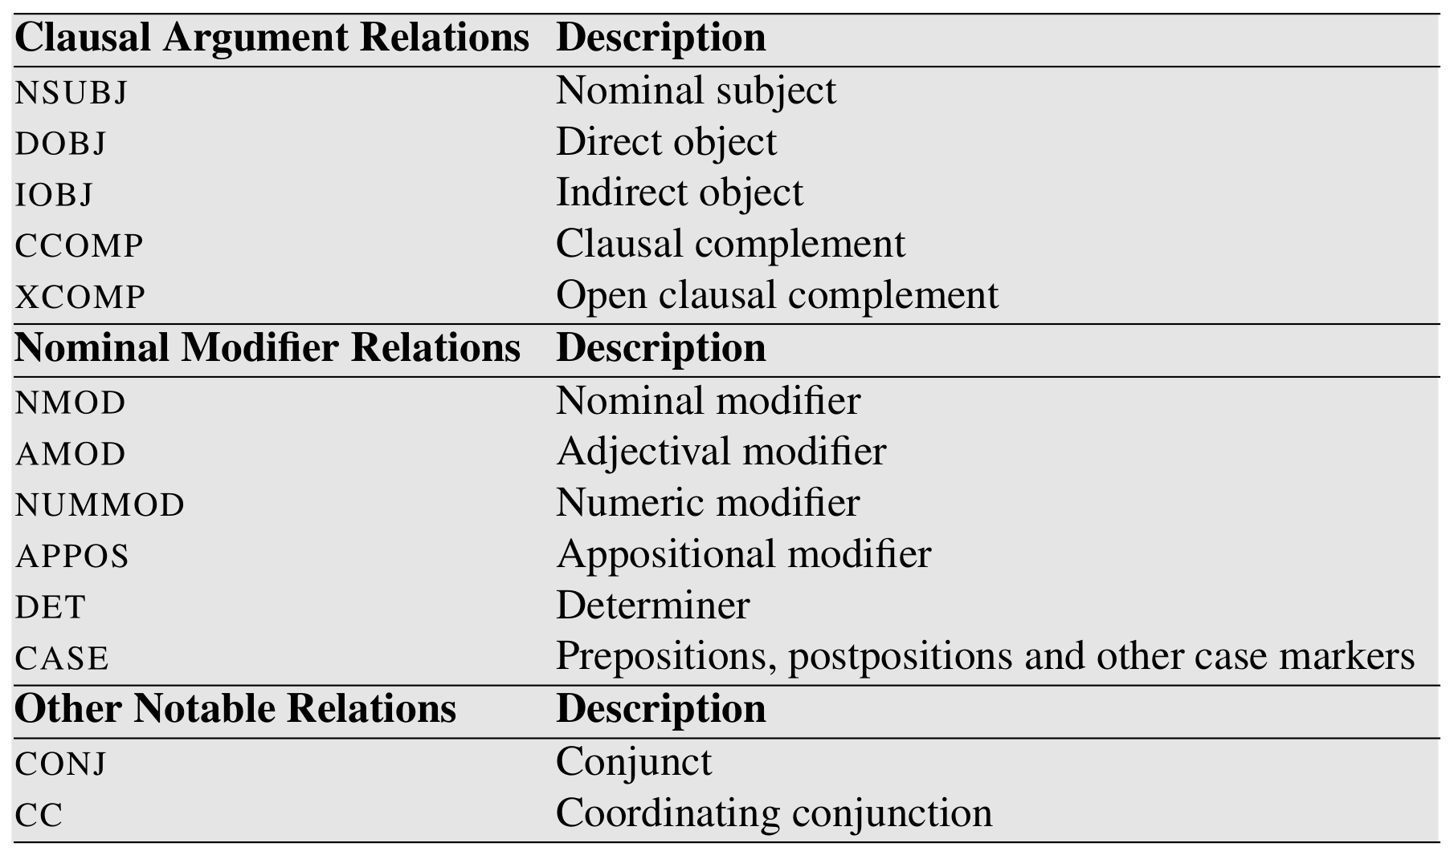
Dependency Labels

Slide 72
Dependency Trees
Notes:
Parent/head/governor, child/dependent/modifier, label/relation/type
Connected, acyclic, single-head, projective

Slide 73
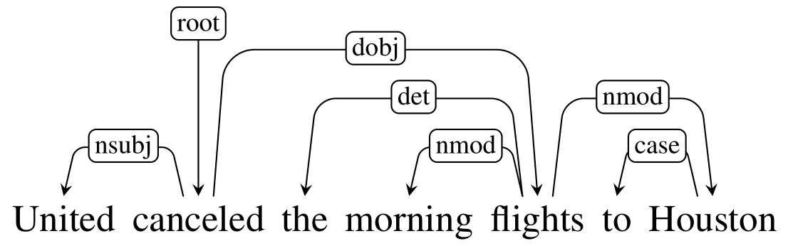
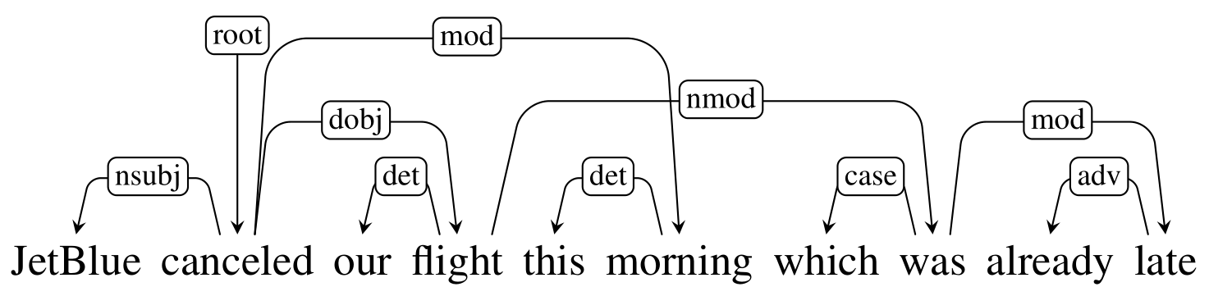
Projective vs Non-projective

Slide 74
Evaluating Dependency Parses
ROOT She saw the video lecture
0 1 2 3 4 5
ROOT She saw the video lecture
0 1 2 3 4 5
Gold
2 She nsubj
0 saw root
5 the det
5 video nn
2 lecture dobj
Parsed
2 She nsubj
0 saw root
4 the det
5 video nsubj
2 lecture ccomp
Notes:
Labeled attachment score, unlabeled attachment score

Slide 75
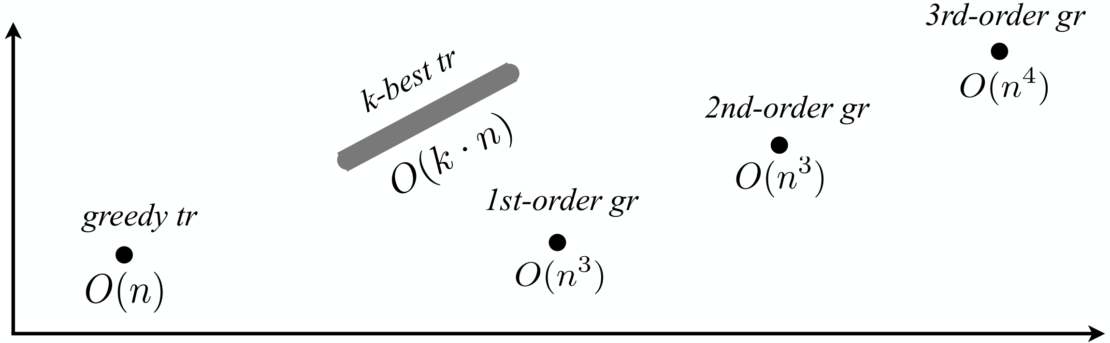
Parsing Algorithms
Transition-based
Graph-based
Fast, greedy, linear-time
Trained for greedy search
Features decide what to do next
Beam search, i.e. k-best
Slower, exhaustive algorithms
Dynamic programming, inference
Features used to score whole trees
Accuracy
Running time

Slide 76
Graph-based Parsing
Notes:
Arc-factored (1st order), 2nd order, 3rd order, and so on
Dynamic Programming for projective, MST for non-projective

Slide 77
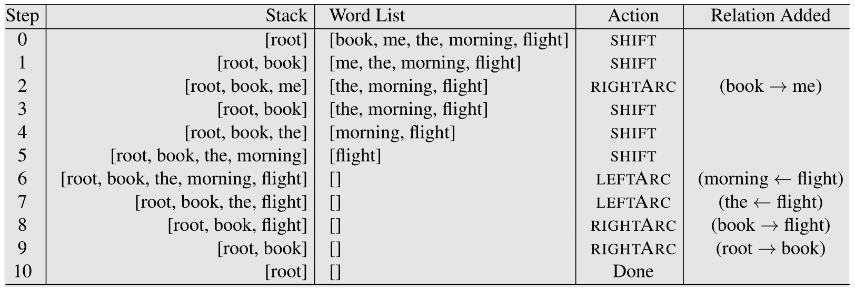
Transition-based Parsing

Slide 78
Transition-based Parsing

Slide 79
Transition-based Parsing

Slide 80
Transition-based Parsing

Slide 81
Transition-based Parsing

Slide 82
Transition-based Parsing

